Slide 1


Language Models on Question Answering problems
Author: Enrique Saiz Oubiña
Advisor: Manuel Antonio Sánchez-Montañés Isla
1

Slide 2
Contents
Motivation and goals
State of the art
Technology and environment
Experimental setup
Results
Conclusions
2

Slide 3
Contents
Motivation and goals
State of the art
Technology and environment
Experimental setup
Results
Conclusions
3

Slide 4





Motivation
Field with bright future.
Powerful technology that finally bloomed last year.
Goals
Analyze state of NLP and LLMs.
Finetune selected language models on QA tasks.
Evaluate and compare the finetuned models.
Gather results and extract principles and recommendations.
Release the results of this work.
4

Slide 5
Contents
Motivation and goals
State of the art
Natural Language Processing
The transformer
Transformer architectures
Large Language Models
Training LLMs
Question Answering
Extractive QA
Technology and environment
Experimental setup
Results
Conclusions
5

Slide 6
State of the art: Natural Language Processing (NLP)
Feedforward
Neural
Networks
Transformer
architecture
Context-free
grammars
Regular
expression
syntax
N-gram
word model
Recurrent
Neural
Networks
Lexers
Parsers
2017
1950
1980
2000
Symbolic NLP
Statistical NLP
Neural NLP
6
Notes:
1950s symbolic NLP
context-free grammars
regular expression syntax
lexers
parsers
1980s statisical nlp
N-gram word models
2000 neural nlp
Feedforward Neural Network
Recurrent Neural Network
2017 paper Attention is All You Need
Transformer architecture
GPT, BERT, LLaMA, T5

Slide 7
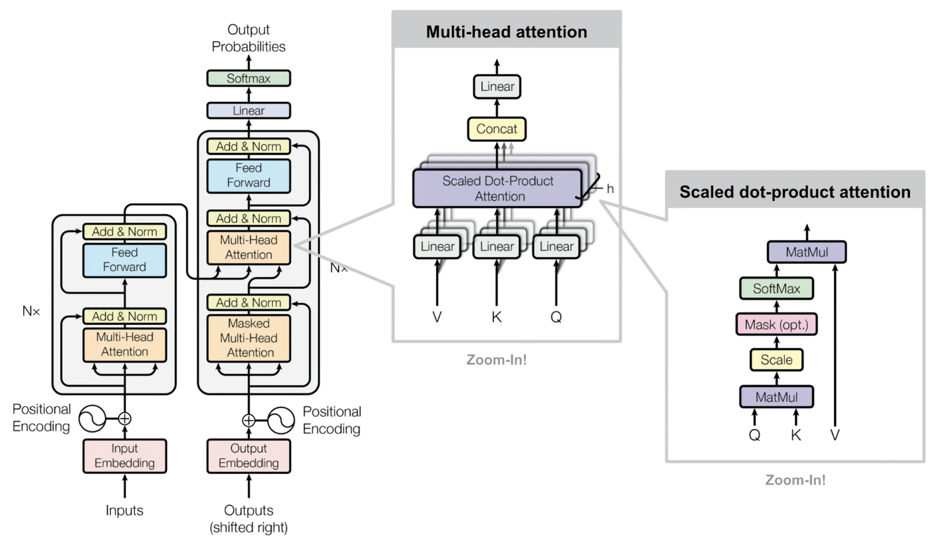
State of the art: the transformer
Multi-head Attention Mechanism + Feedforward Neural Networks
Extracted from https://arxiv.org/abs/1706.03762
7
Notes:
The transformer relies on the multi head attention mechanism and feedforward neural networks.
Encoder to the right, decoder to the left. The magic happens in the internal layers, where the attention is computed with the Query, Key, Value matrices.
Attention is the importance that each token has with every other token in the sequence. It allows to represent relations among tokens that shape the language understanding.
This attention is computed in different heads, thus generating richer interpretations of the language.
---
1 o 2 min
Ver https://jalammar.github.io/illustrated-transformer/
https://magazine.sebastianraschka.com/p/understanding-encoder-and-decoder
https://velog.io/@jiyoung/Transformer-%EA%B5%AC%ED%98%84%ED%95%98%EA%B3%A0-%EC%9D%B4%ED%95%B4%ED%95%98%EA%B8%B02
Zoom in !! https://www.researchgate.net/figure/Encoder-decoder-architecture-of-the-Transformer-developed-by-Vaswani-et-al-28_fig1_355339249
https://arxiv.org/abs/1706.03762

Slide 8
State of the art: transformer architectures
Encoder-only
Encoder-decoder
Decoder-only
Excels at understanding: Word or Sentence classification, Extractive QA.
Excels at Text translation, Summarization, Generative QA.
Excels at Text generation.
The largest models. Tendency to scale their size.
Examples: BERT, RoBERTa
Examples: T5, BART
Examples: GPT, LLaMA, Phi
8
Notes:
1 o 2 min
Ver https://jalammar.github.io/illustrated-transformer/
https://magazine.sebastianraschka.com/p/understanding-encoder-and-decoder
https://velog.io/@jiyoung/Transformer-%EA%B5%AC%ED%98%84%ED%95%98%EA%B3%A0-%EC%9D%B4%ED%95%B4%ED%95%98%EA%B8%B02

Slide 9
State of the art: Large Language Models (LLMs)
Transformer-based models.
Highly capable of understanding and generating language.
Large sizes: from millions to billions of parameters.
Trained in massive corpus of data.
Versatile, can be adapted to a certain domain or task.
9

Slide 10
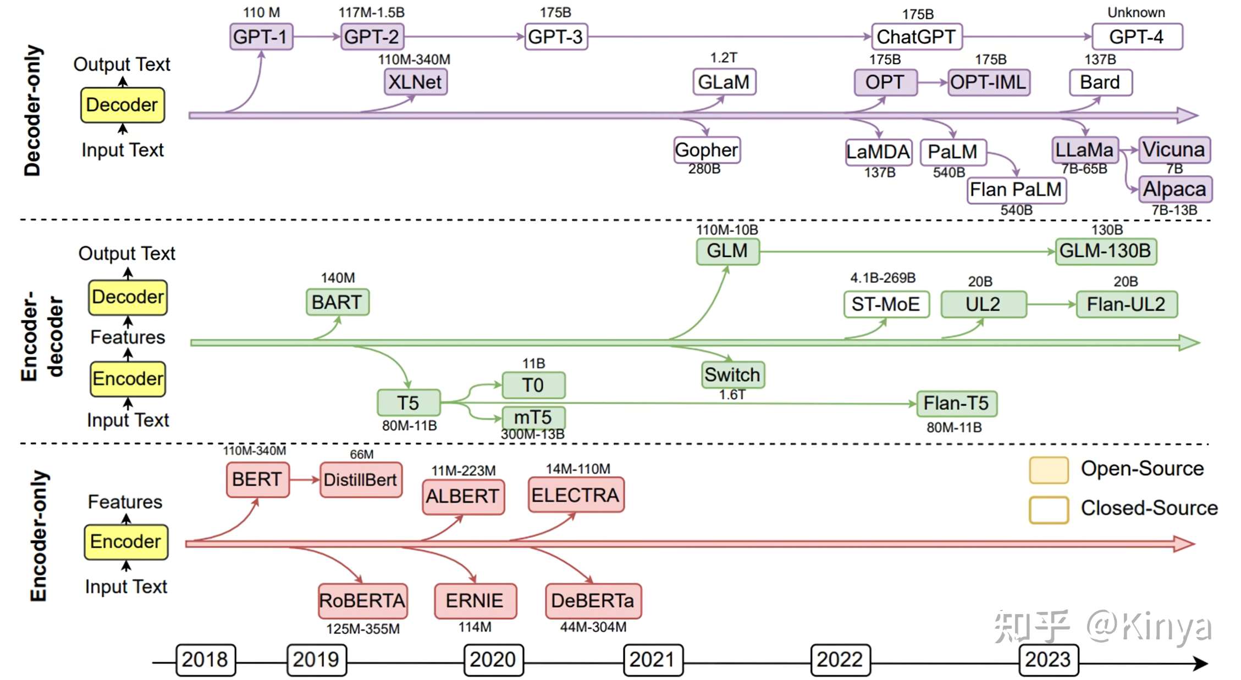
State of the art: Large Language Models (LLMs)
Phi-2
Phi-3
Extracted from https://zhuanlan.zhihu.com/p/637918341
10
Notes:
https://zhuanlan.zhihu.com/p/637918341 https://pic4.zhimg.com/v2-daa30b7f64e7e661622e284fcd22330f_r.jpg

Slide 11
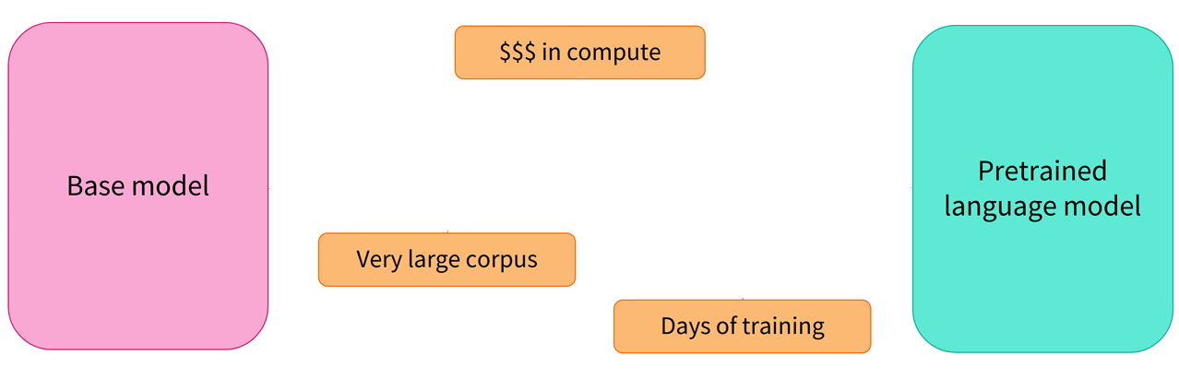
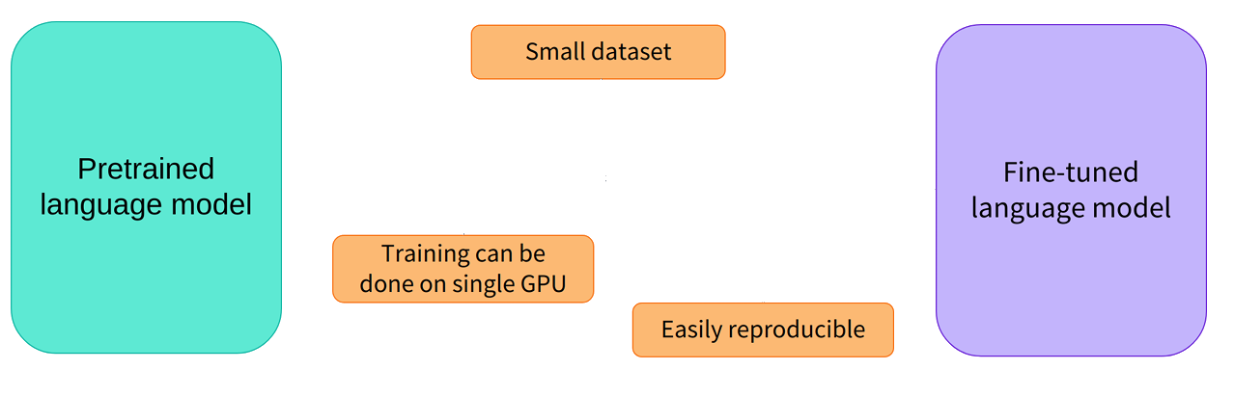
State of the art: training LLMs
Extracted from https://huggingface.co/learn/nlp-course/chapter1/4
Pretraining
Finetuning
11

Slide 12
State of the art: Question Answering (QA)
Generative QA
(open-book)
Closed generative QA (closed-book)
Extractive QA
Context: The national bird of Saint Helena is the Saint Helena plover. It appears on the coat of arms of Saint Helena and on the flag.
Question: What is the national bird of Saint Helena?
Context: When two bodies are not in a state of thermal equilibrium, heat will flow from the hotter to the colder.
Question: Why does water heated to room temperature feel colder than the air around it?
Context: -
Question: What are common symptoms of the flu?
Answer: the Saint Helena plover
Answer: Water gains heat from the air, thus it feels colder than the surrounding air.
Answer: Fever, chills, cough, sore throat, stuffy nose, muscle or body aches, headaches, and fatigue.
Answer is extracted directly from the context.
Answer is generated freely based on the context.
Answer is generated freely, without given context.
12
Notes:
https://www.pinecone.io/learn/series/nlp/question-answering/

Slide 13
State of the art: extractive QA
Context
Question
Answer
pre-process!
Encoder-only
decode!
start position
end position
post-process!
pre-process!
Encoder-decoder
decode!
sequence
post-process!
pre-process!
Decoder-only
text generation
post-process!
decode!
Input
Model
Output
Prediction
13

Slide 14
Contents
Motivation and goals
State of the art
Natural Language Processing
The transformer
Transformer architectures
Large Language Models
Training LLMs
Question Answering
Extractive QA
Technology and environment
Experimental setup
Results
Conclusions
14

Slide 15
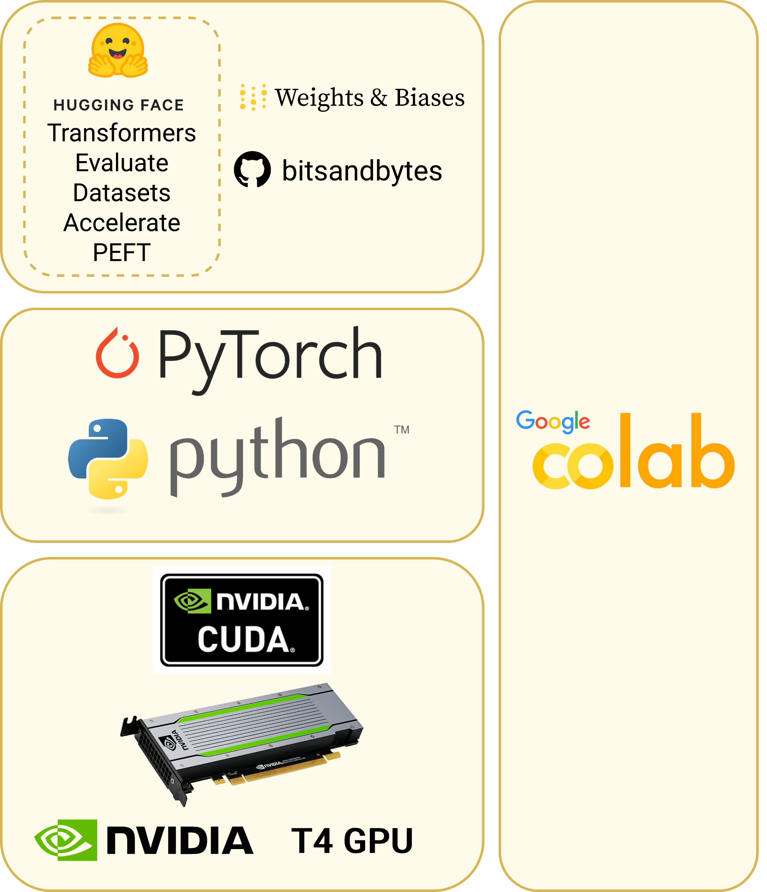




Technology and environment
Constraints
Finite computing time: 2-3hrs per session
Apply transfer learning
Limited HW: barely 16GB of vRAM
Gradient accumulation, Quantization
No persistent storage
HuggingFace Hub repositories
15
Notes:
Why? Pros and cons of each. Alternatives
constraints
• Finite computing time, ranging from 2 to 3 hours per session, which can be enhanced by applying transfer learning techniques to finetune the model in several sessions.
• Limited hardware, as T4 GPUs are equipped with barely 16GB of vRAM. Training issues can be overcome by using gradient accumulation steps, effectively increasing the actual batch size, as seen in the equation 3.1. While large models do not fit in this hardware, relatively small models can be loaded and finetuned by using quantization techniques. effective_batch_size = Ndevices × batch_sizedevice × gradient_accumulation_steps (3.1)
• No persistent storage. However, HuggingFace provides utilities to upload datasets and model checkpoints to their repositories for later download and use. Moreover, repositories may also be shared for exploitation by other parties.

Slide 16
Contents
Motivation and goals
State of the art
Technology and environment
Experimental setup
Dataset
Models
Finetuning
RoBERTa
T5
Phi
Metrics and evaluation
Results
Conclusions
16

Slide 17
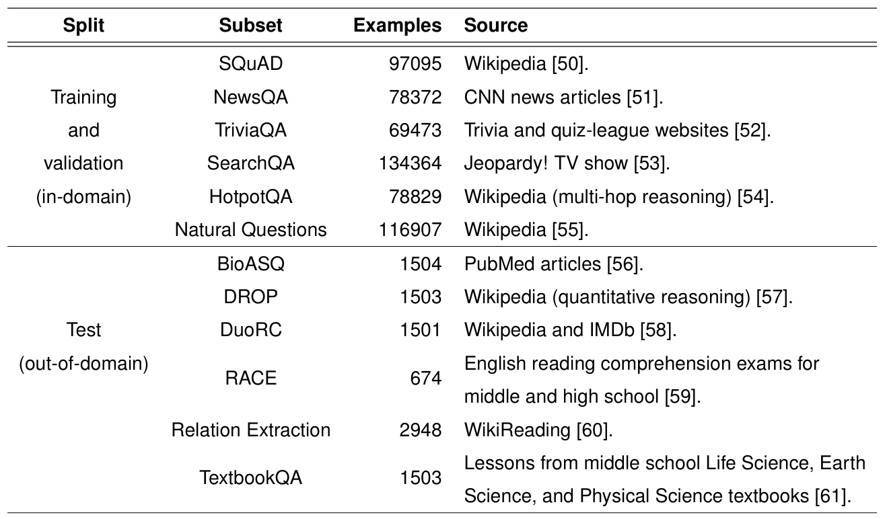
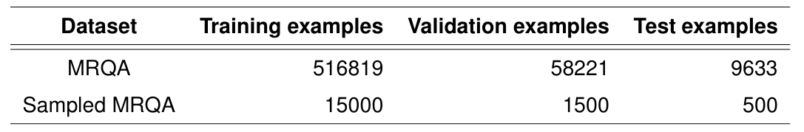
Experimental setup: dataset
MRQA dataset: Context-Question-Answer examples for extractive QA.
We sample it:
17

Slide 18
Experimental setup: dataset example
ID: “240cdd7132cf4660b3b183604f97278e”
Subset: “SQuAD”
Context: "During the war years Universal did have a co-production arrangement with producer Walter Wanger and his partner, director Fritz Lang, lending the studio some amount of prestige productions. Universal's core audience base was still found in the neighborhood movie theaters, and the studio continued to please the public with low- to medium-budget films. Basil Rathbone and Nigel Bruce in new Sherlock Holmes mysteries (1942–46), teenage musicals with Gloria Jean, Donald O'Connor, and Peggy Ryan (1942–43), and screen adaptations of radio's Inner Sanctum Mysteries with Lon Chaney, Jr. (1943–45). Alfred Hitchcock was also borrowed for two films from Selznick International Pictures: Saboteur (1942) and Shadow of a Doubt (1943).“
Question: "In what period did film versions of Inner Sanctum Mysteries appear?”
Answers: { "answer_start": [ 586 ], "text": [ "1943–45" ] }
18

Slide 19
Experimental setup: models
Families
Base models
Finetuned models
RoBERTa
(encoder-only)
Base RoBERTa
Finetuned RoBERTa
VMware’s RoBERTa
Finetuned reference RoBERTa
Reference model!
T5 Base
Finetuned T5 Base
T5
(encoder-decoder)
T5 Small
Finetuned T5 Small
FLAN-T5 Base
Finetuned FLAN-T5 Base
Similar training size!
FLAN-T5 Small
Finetuned FLAN-T5 Small
Phi
(decoder-only)
Base Phi-2
Finetuned Phi-2
PEFT!!
Base Phi-3
Finetuned Phi-3
19

Slide 20
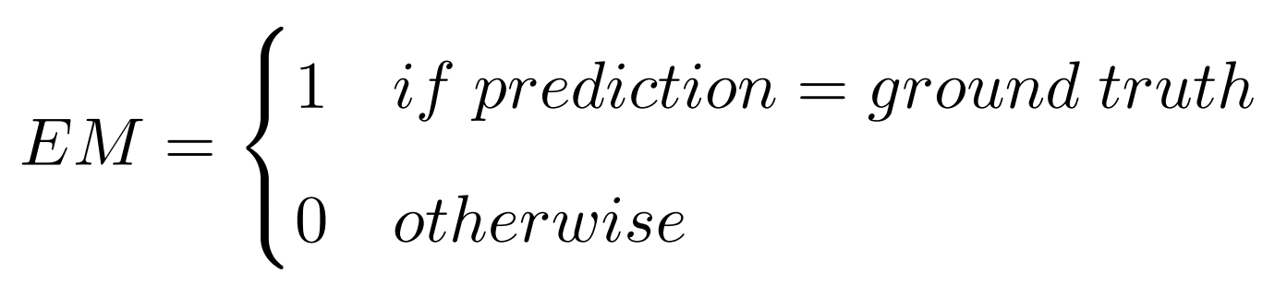
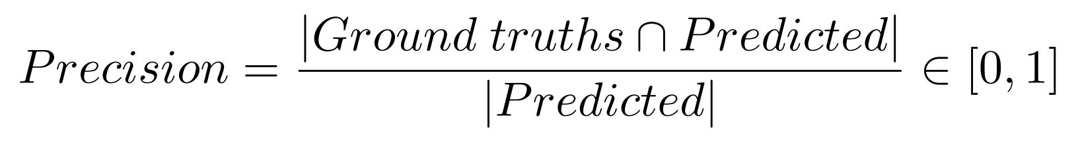
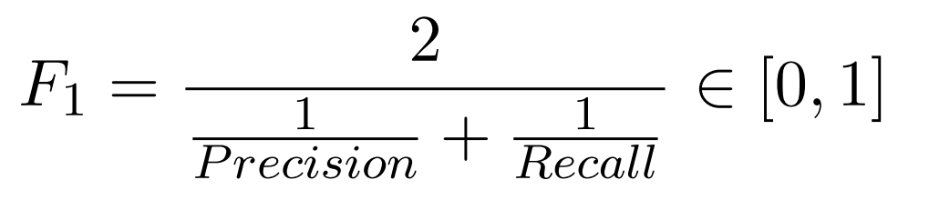
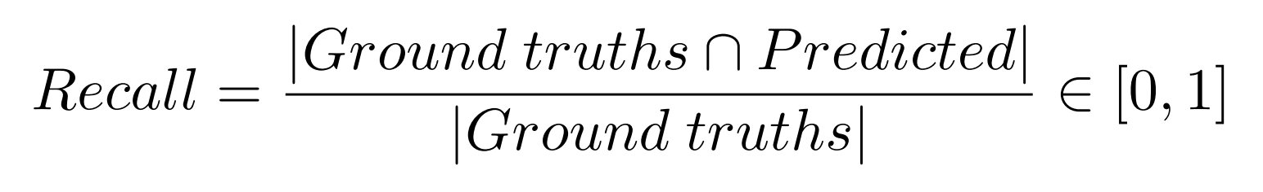
Experimental setup: metrics and evaluation
MRQA official evaluation procedure: Exact Match (EM) and F1.
F1 punishes low values of Precision or Recall.
Precision measures accuracy, Recall measures completeness.
20
Notes:
EM is not really representative
F1 is the harmonic mean of Precision and Recall, at word level
Precision measures accuracy of the answer, while Recall measures completeness
The harmonic mean will punish low values of Precision or Recall

Slide 21
Contents
Motivation and goals
State of the art
Technology and environment
Experimental setup
Results
RoBERTa
FLAN T5 vs. default T5
T5 Small vs. T5 Base at half precision
Phi and the generation strategy
Examples
Conclusions
21

Slide 22
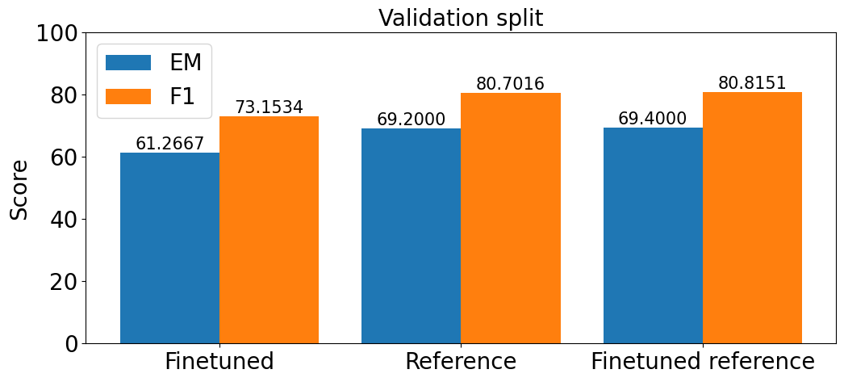
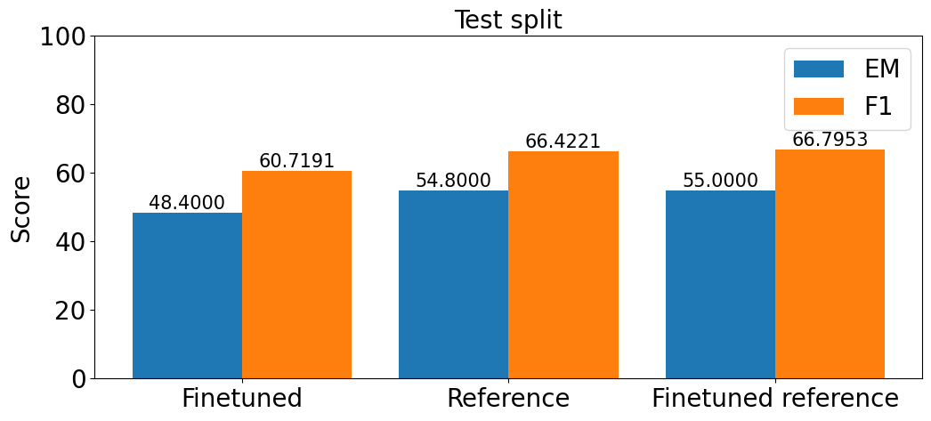
Results: RoBERTa
Best results are obtained after further finetuning the reference model.
22

Slide 23
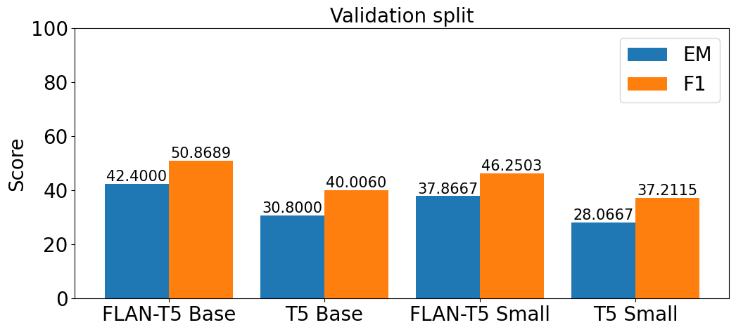
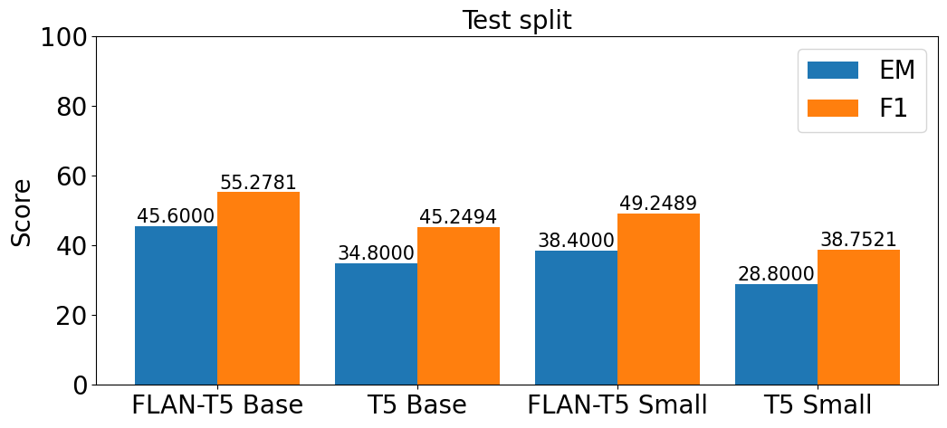
Results: FLAN T5 vs. default T5
In all cases (Base and Small, validation and test),
FLAN outperforms its default T5 counterpart.
23

Slide 24
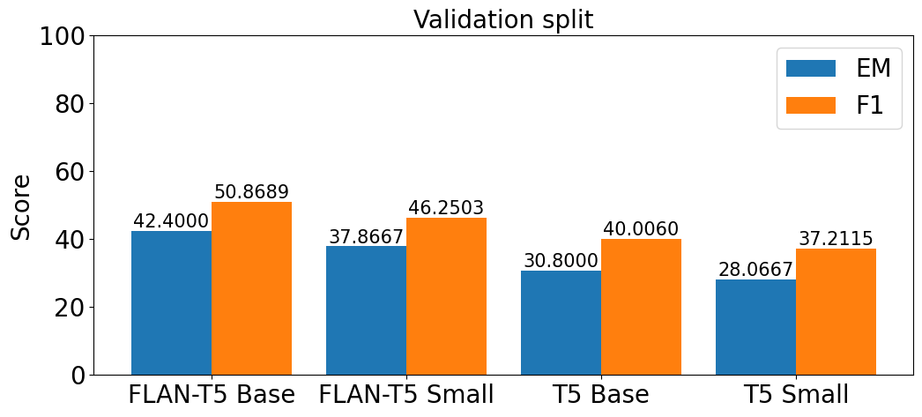
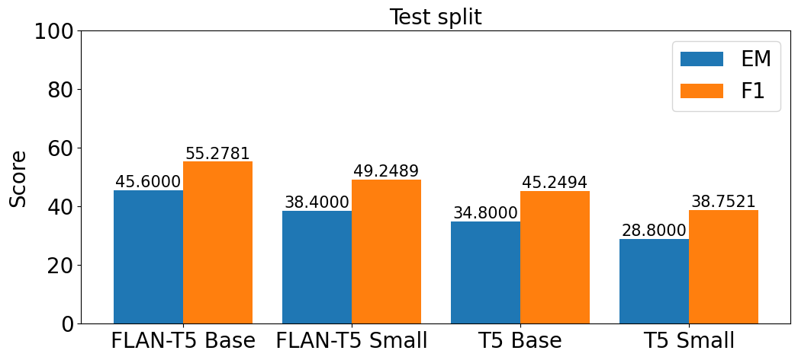
Results: T5 Small vs. T5 Base at half precision
Finetuning T5 Small has similar memory usage as finetuning T5 Base at half precision but…
…do they perform similarly?
In all cases (FLAN and default, validation and test),
T5 Base outperforms its Small T5 counterpart.
24

Slide 25
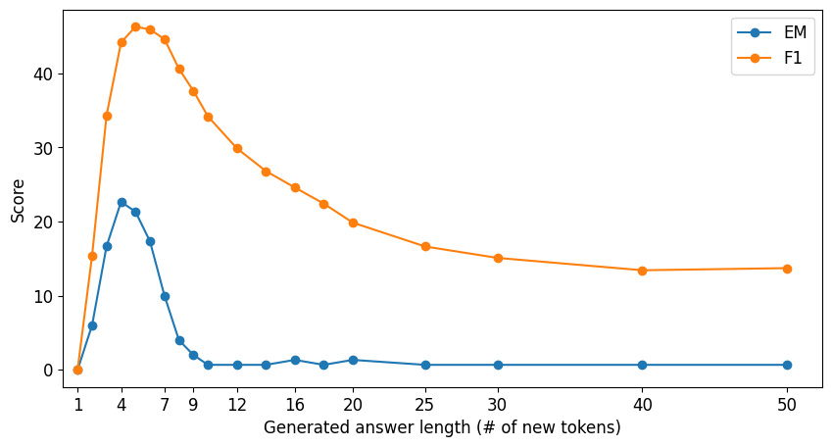
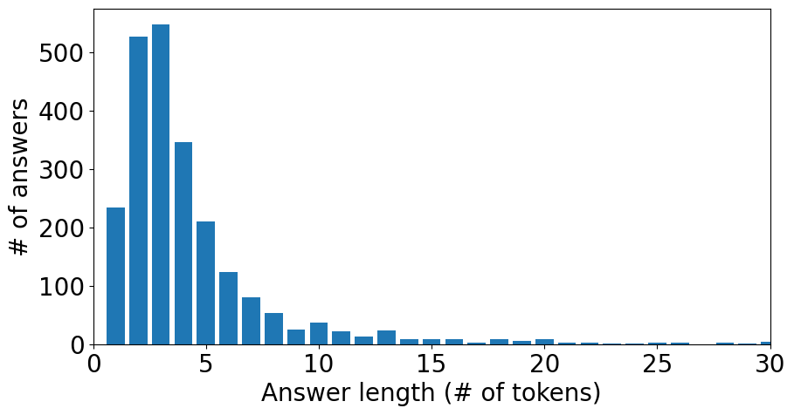
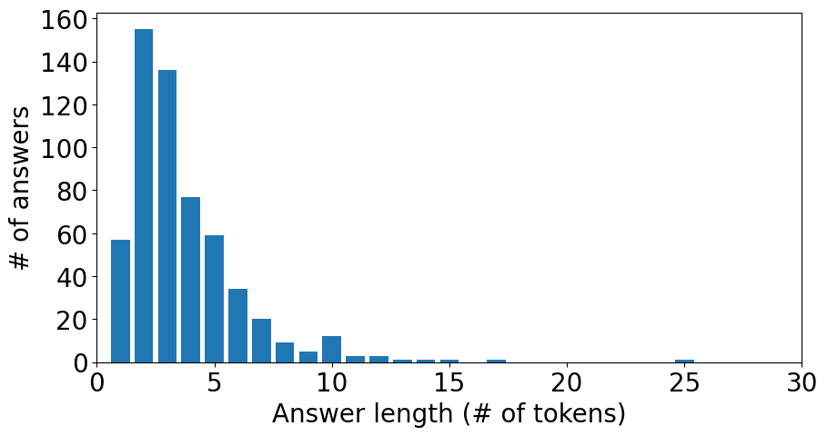
Results: Phi and the generation strategy
Test split
Validation split
Optimal generation strategy: 5 new tokens
Why?
25

Slide 26
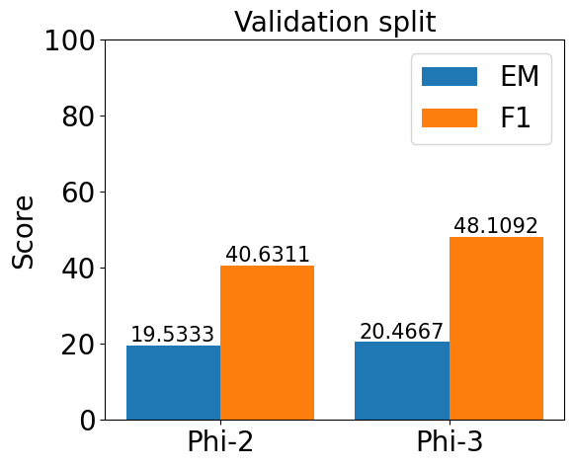
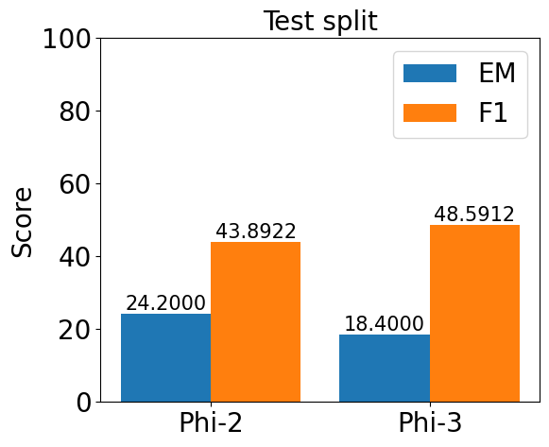
Results: Phi
Phi-3 outperforms Phi-2. Expected, since Phi-3 is newer and 30% larger.
26

Slide 27
Results: examples
Context: "[PAR] [TLE] Louis Smith (musician) [SEP] While studying at the University of Michigan, he played with visiting musicians such as Dizzy Gillespie, Miles Davis, Thad Jones and Billy Mitchell, before going on to play with Sonny Stitt, Count Basie and Al McKibbon, Cannonball Adderley, Percy Heath, Philly Joe Jones, Lou Donaldson, Donald Byrd, Kenny Dorham and Zoot Sims. [PAR] [TLE] Miles Davis [SEP] Miles Dewey Davis III (May 26, 1926September 28, 1991) was an American jazz trumpeter, bandleader, and composer. He is among the most influential and acclaimed figures in the history of jazz and 20th century music. Davis adopted a variety of musical directions in his five-decade career which kept him at the forefront of a number of major stylistic developments in jazz.“
Question: "While at the University of Michigan, Louis Smith played with what American jazz trumpeter, bandleader, and composer?"
Answer: "Miles Dewey Davis III“
RoBERTa prediction: "Miles Davis" (EM: 0.0%, F1: 66.7%)
T5 prediction: "Miles Dewey Davis III" (EM: 100.0%, F1: 100.0%)
Phi prediction: "Miles Davis\nQuestion" (EM: 0.0%, F1: 57.1%)
Observations
EM is not very reliable.
In RoBERTa case, F1 fails to identify entity semantics.
Phi presents generation problems; generation strategy alleviates them.
27
Notes:
Example from the HotpotQA subset in the validation split. Evaluates multi-hop reasoning
RoBERTa understands the concept
RoBERTa Pinpoints the correct entity
…But RoBERTa is not correct
Why ?
Two reasons:
Ground truths are not 100% correct
F1 fails to indentify entity semantics.
F1 metric fails because it highly depends in ground truth
Is T5 ‘s answer better than RoBERTa’s?
We can argue that
F1 metric does indeed reflect this difference

Slide 28
Results: examples
Context: "The 52nd government of Turkey (30 October 1995 – 6 March 1996) was a caretaker coalition government formed by True Path Party (DYP) and Republican People’s Party (CHP).“
Question: "What year did 52nd government of Turkey start?"
Answer: “1995“
RoBERTa prediction: “1995“ (EM: 100.0%, F1: 100.0%)
T5 prediction: “1995“ (EM: 100.0%, F1: 100.0%)
Phi prediction: “1995“ (EM: 100.0%, F1: 100.0%)
Observations
All models succeed at date reasoning.
Generation with numbers is straightforward: no problems for Phi.
28
Notes:
Example from the RelationExtraction subset in the test split.

Slide 29
Results: examples
Context: “… Coal, oil, and natural gas are fossil fuels. … Millions of years ago, plants used energy from the Sun to form sugars, carbohydrates, and other energy-rich carbon compounds. As plants and animals died, their remains settled on the ground on land and in swamps, lakes, and seas. Over time, layer upon layer of these remains accumulated. … After millions of years of heat and pressure, the material in these layers turned into chemicals called hydrocarbons (Figure 1.2). Hydrocarbons are made of carbon and hydrogen atoms. This molecule with one carbon and four hydrogen atoms is methane. Hydrocarbons can be solid, liquid, or gaseous. The solid form is what we know as coal. The liquid form is petroleum, or crude oil. Natural gas is the gaseous form. The solar energy stored in fossil fuels is a rich source of energy. Although fossil fuels provide very high quality energy, they are non-renewable. “
Question: "hydrocarbons in gas form are called __________________."
Answer: “natural gas“
RoBERTa prediction: "methane" (EM: 0.0%, F1: 0.0%)
T5 prediction: "natural gas" (EM: 100.0%, F1: 100.0%)
Phi prediction: "natural gas\nQuestion:" (EM: 0.0%, F1: 80.0%)
Observations
All models succeed with the new question format.
RoBERTa prediction is interesting, since methane is a natural gas.
Phi, once more, showcases generation issues.
29
Notes:
Example from the TextBookQA subset in the test split.

Slide 30
Contents
Motivation and goals
State of the art
Technology and environment
Experimental setup
Results
RoBERTa
FLAN T5 vs. default T5
T5 Small vs. T5 Base at half precision
Phi and the generation strategy
Examples
Conclusions
Future work
Repositories
30

Slide 31


Conclusions: main takeaways
Not a matter of size,
but of architecture
Finetuning is very beneficial
and relatively inexpensive
FLAN is better than
the default model
Phi-3 is the largest model, yet it is outperformed by RoBERTa and T5.
Encoder-only models excel at extractive QA tasks, followed by encoder-decoders and decoder-only.
In T5’s case, FLAN outperforms its default counterpart in our task.
If available, embrace instruction finetuned models.
Finetuning to pretraining
1 : 300 000 FLOP
31

Slide 32
Conclusions: main takeaways
Leverage community
models wisely
Training larger models on lower
precision may be a good idea
Optimize text generation with decoder models.
Our best model was finetuned from a community checkpoint (VMware’s RoBERTa).
Further finetune carefully to avoid overfitting.
For the same training size, finetuned T5 Base in half precision outperforms T5 Small in our task.
Special attention to possible training stability issues.
Text generation is Phi’s Achilles’ heel in our task.
Optimize generation strategy to your dataset and task.
32
Notes:
Conclusions: Pre-processing, formatting and tokenization is important. (esta igual se va al traste)

Slide 33




Conclusions: future work
Employ more capable hardware to enhance results.
Implement complex evaluation methods, such as Semantic Answer Similarity.
Explore generative QA, with a new dataset and models.
Further explore the NLP field: RAG, testbeds, deployments, etc.
33

Slide 34


Conclusions: repositories
github.com/enriquesaou/tfg-lm-qa
huggingface.co/collections/enriquesaou/tfg-66670a768e3ed59181581e65
Any questions?
¿Preguntas?
34

